Slide 1
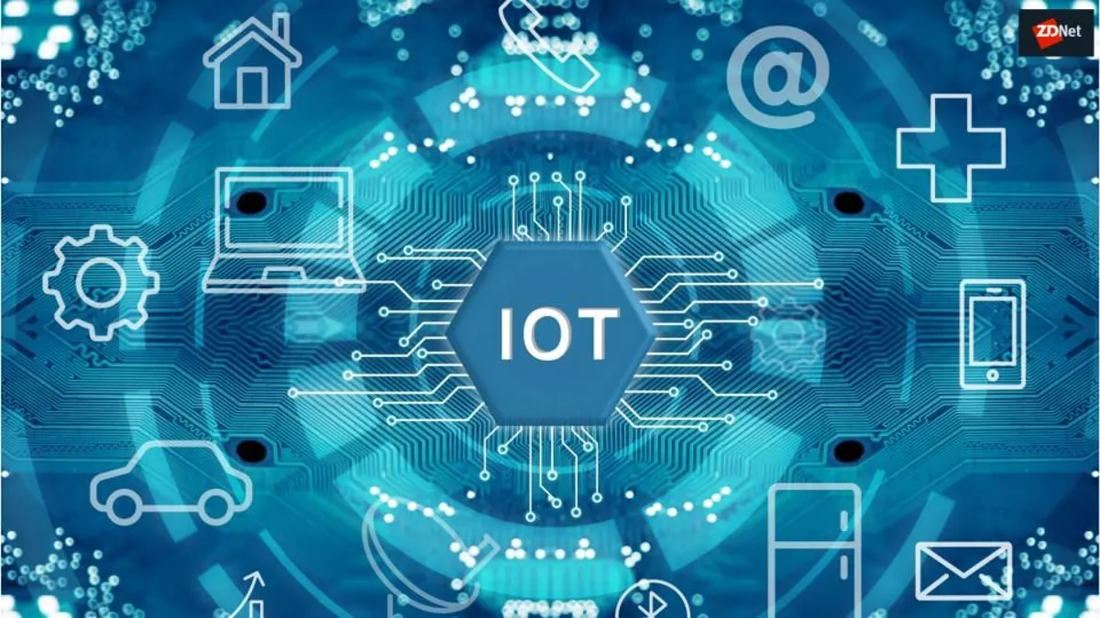

Slide 2
What Is IOT?
The Internet of things (IoT) describes physical objects (or groups of such objects) with sensors, processing ability, software and other technologies that connect and exchange data with other devices and systems over the Internet or other communications networks.

Slide 3
Why IOT Technology most popular?
Advancements in technology
An increased demand for automation
The growing popularity of smart homes and cities
The impact of Industry 4.0
Government incentives and investments.

Slide 4
Devices of IOT

Slide 5
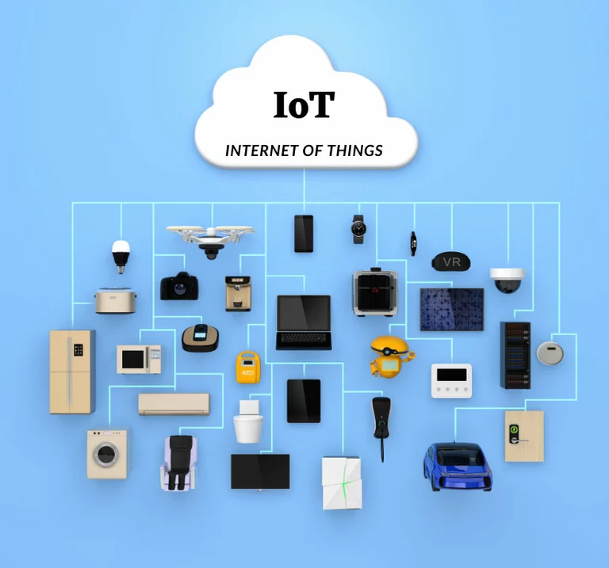

Slide 6
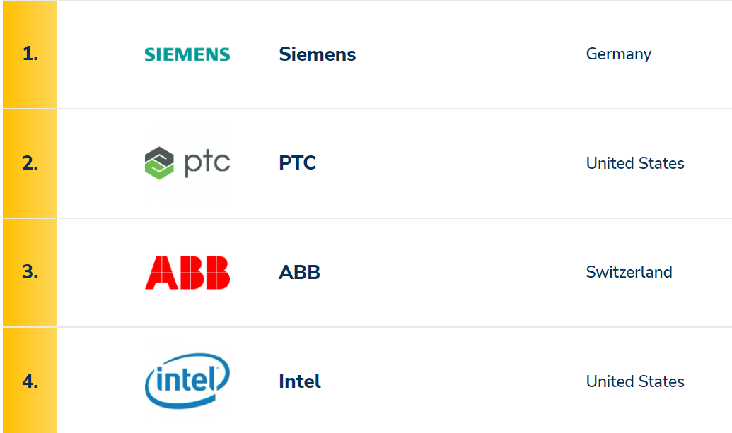
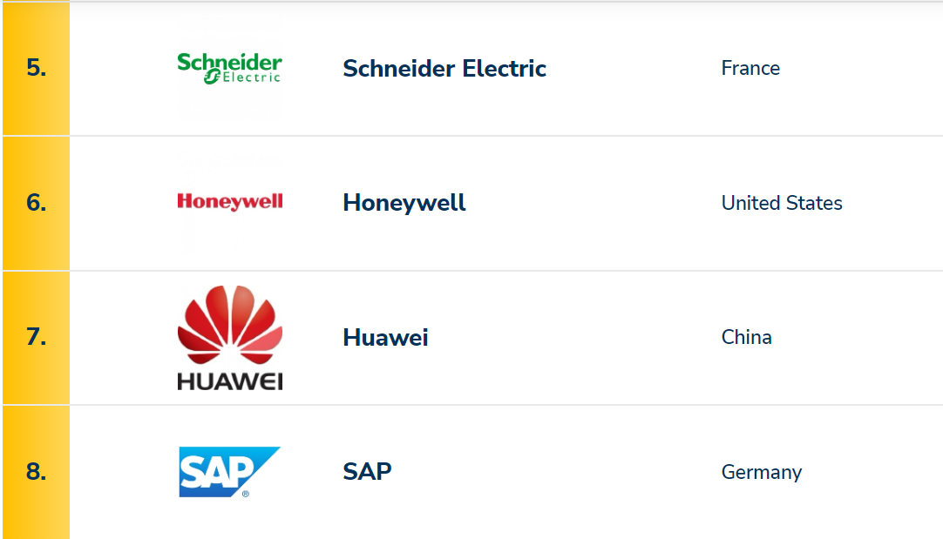
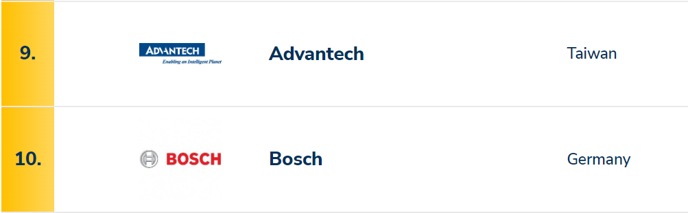
Top 10 IOT Companies

Slide 7
How to become an IOT Developer?

Slide 8
How to become an IOT Developer?
1. Gain a deep understanding of sensors
2. Focus on user interface
3. Learn JavaScript or Python
4. Play with a Raspberry Pi
5. Find a community
6. Keep your skills cutting edge

Slide 9
Advantages of developing IOT

Slide 10
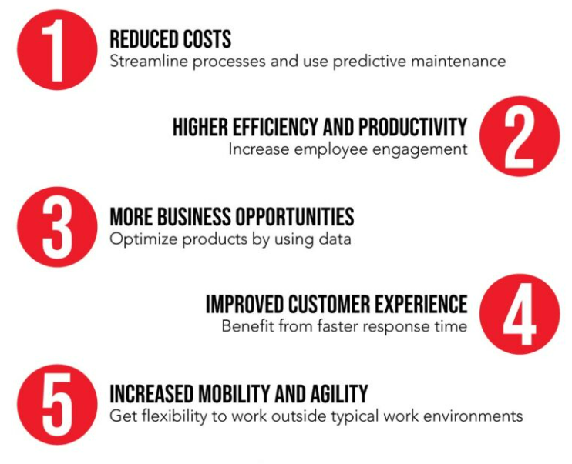
Top five advantages of the IoT:

Slide 11
Relationship Between IOT and Arduino
Several IoT applications frequently use Arduino.
Every year, the number of connected devices increases by billions worldwide.
Whit an intuitive user interface and an all-in-one solution for configuration, coding, uploading, and visualization, the Arduino IoT Cloud is a platform anybody can use to develop IoT projects.

Slide 12
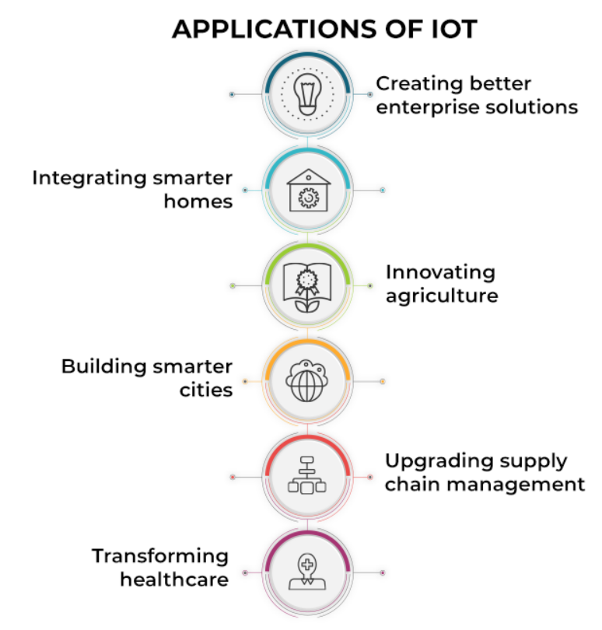

Slide 13
Example Of Using IOT
-Auto Water Pump System
-Fire Alarm System
-Smart Home System

Slide 14


